Slide 1

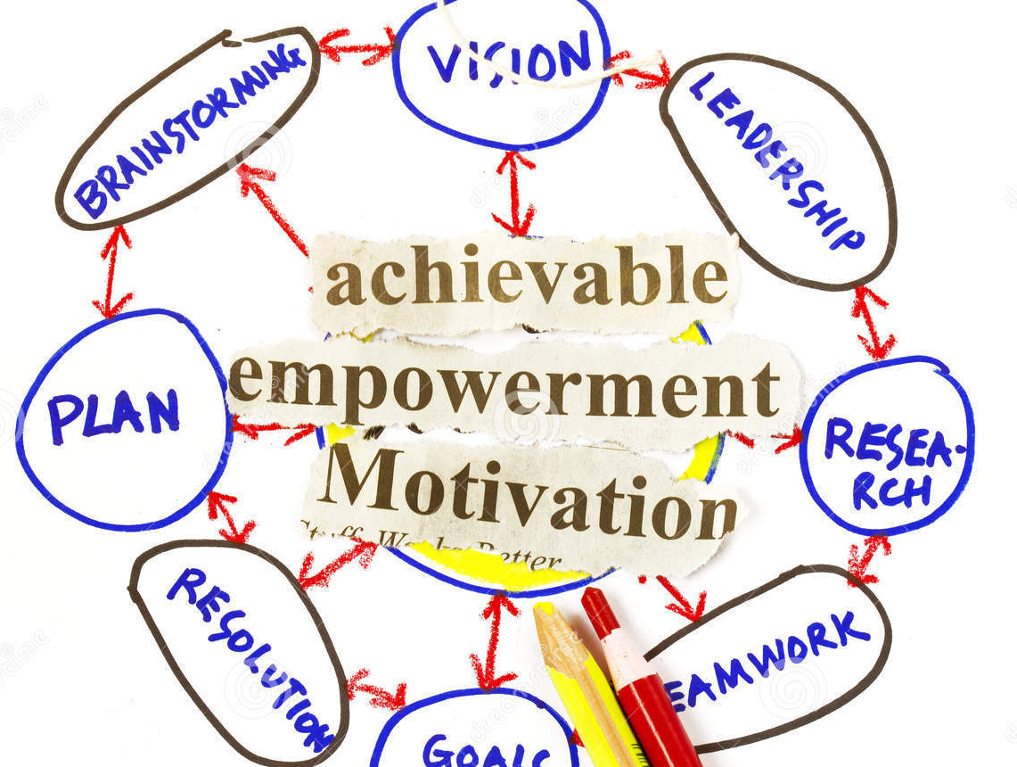
PRINCIPLES OF LEADERSHIP MOTIVATION & EMPOWERMENT
SPRING 2023
CHAPTER 08
FAREED QURESHI

Slide 2
CHAPTER OBJECTIVES
Recognize and apply the difference between intrinsic and extrinsic rewards.
Motivate others by meeting their higher-level needs.
Apply needs-based theory of motivation.
Avoid the disadvantages of “carrot-and-stick” motivation.
Implement empowerment by providing the five elements of information, knowledge, discretion, meaning, and rewards.

Slide 3
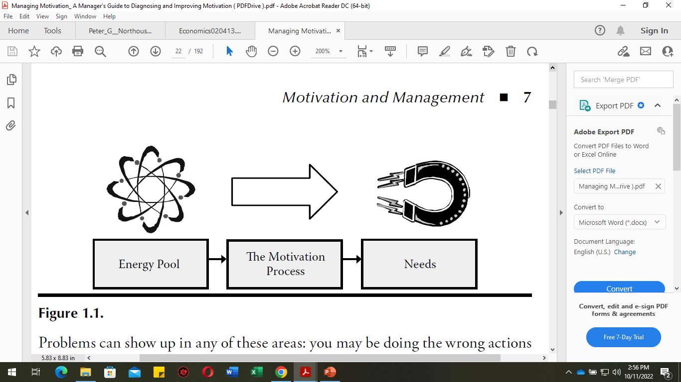
MOTIVATION
MOTIVATION is the PROCESS used to ALLOCATE ENERGY to MAXIMIZE the SATISFACTION of NEEDS
Direction: Which actions we will work on
Effort: How hard we will work on those actions
Persistence: How long we will work on those actions

Slide 4
A SIMPLE MODEL OF MOTIVATION
NEEDS
Creates desire to fulfill needs (money, friendship, recognition, achievement
BEHAVIORS
Results in actions to fulfill needs
REWARDS
Satisfy needs: intrinsic or extrinsic rewards
Feedback Reward informs person whether behavior was appropriate and should be used again

Slide 5
TYPES OF REWARDS
Intrinsic Rewards
Internal satisfactions a person receives in the process of performing a particular action
Extrinsic Rewards
Rewards given by another person, typically a supervisor, such as pay increases and promotions
System-wide Rewards
Rewards that apply the same to all people within an organization or within a specific category or department

Slide 6
EXAMPLES OF INT. & EXT REWARDS
Extrinsic
Intrinsic
Individual
Large merit increase
Feeling of self-fulfillment
Pride in being part of a “winning” organization
Systemwide
Insurance benefits

Slide 7
Needs of People and Motivation Methods
NEEDS OF
PEOPLE
Conventional management
Leadership
Lower needs
Higher needs
Carrot and stick (Extrinsic)
Empowerment (Intrinsic)
Control people
Growth and fulfillment
Adequate effort
Best effort

Slide 8
Maslow’s Hierarchy of Needs
Need Hierarchy
Fulfillment on the Job
Self-actualization Needs
Opportunities for advancement, autonomy, growth, creativity
Esteem Needs
Recognition, approval, high status, increased responsibilities
Belongingness Needs
Work groups, clients, coworkers, supervisors
Safety Needs
Safe work, fringe benefits, job security
Physiological Needs
Heat, air, base salary

Slide 9
Herzberg’s Two-Factor Theory
Highly Satisfied
Area of Satisfaction
Motivators
Achievement
Recognition
Responsibility
Work itself
Personal growth
Motivators influence level of satisfaction
Neither Satisfied nor Dissatisfied
Hygiene Factors
Work conditions
Pay/security
Co. policies
Supervisors
Area of Dissatisfaction
Hygiene factors influence level of dissatisfaction
Interpersonal. relationships
Highly Dissatisfied

Slide 10
Acquired Needs Theory
McClelland’s theory that proposes that certain types of needs are acquired during an individual’s lifetime
Three needs most frequently studied:
Need for achievement
Need for affiliation
Need for power

Slide 11
Key Elements of Expectancy Theory
E > P expectancy (Expectancy)
Effort Performance
Will putting effort into the task lead to the desired performance?
Will high performance lead to the desired outcomes?
P > O expectancy (Instrumentality)
Performance Rewards
Valence – value of outcomes
(pay, recognition, other rewards)
Are the available outcomes highly valued?
Motivation

Slide 12
EMPOWERMENT
Empowerment → Power sharing
Employees receive information about company performance.
Employees receive knowledge and skills to contribute to company goals.
Employees have the power to make substantive decisions.
Employees understand the meaning and impact of their jobs.
Employees are rewarded based on company performance.

Slide 13
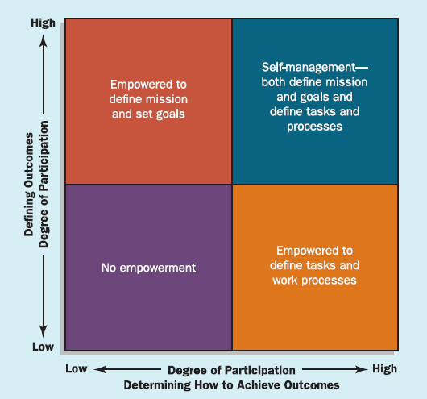

Slide 14

THAT’S ALL FOR TODAY!!
Students be like:
☺

